Slide 1
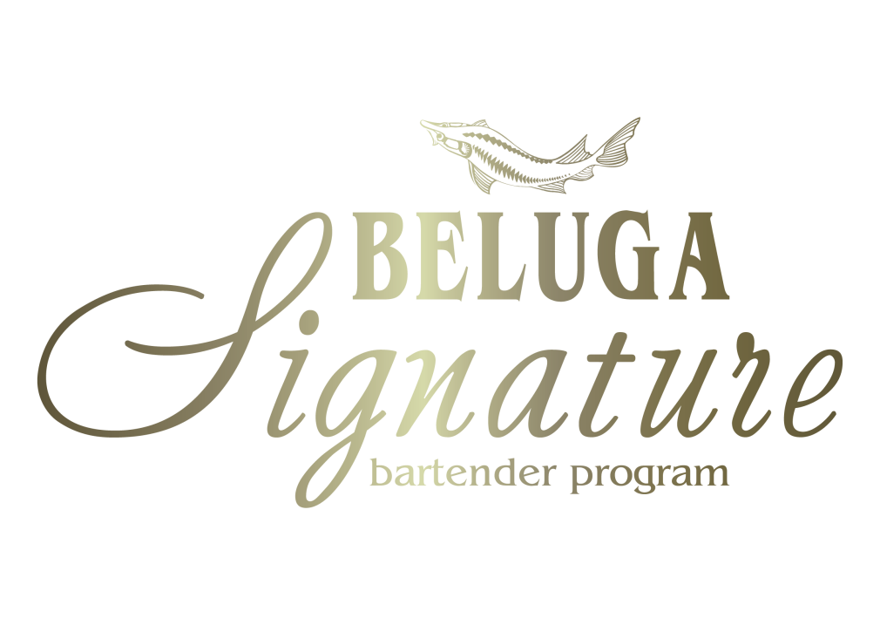


BELUGA SIGNATURE 2019
GLOBAL FINAL
RECIPES
#belugasignature2019
#belugavodka
@vodkabeluga

Slide 2
Sebastian Bauer
The Gelbes Haus, Nuremberg, Germany
The Beluga Way of Life
- Beluga Noble vodka (120 ml)
- Cola-Lime-Cordial (60 ml)
- Fresh Lemon juice (10 ml)
- Beluga Hunting (4 dashes)
#belugasignature2019
#belugavodka
@vodkabeluga

Slide 3
Lucia Montanelli
The Bar at the Dorchester, London, UK
Beluga Dreamers Awake
Beluga Allure vodka (30 ml)
Afternoon Tea Liquor (15 ml)
Grass Tinture (5 ml)
Fake Apricot Vinegar (2 B/S)
#belugasignature2019
#belugavodka
@vodkabeluga

Slide 4
Maxim Gladyshkevich
Friends Cocktail Bar, Novosibirsk, Russia
Essence of Beluga
Beluga Gold Line vodka (50 ml)
Tomato/coconut Cordial (30 ml)
Dry Vermouth infused with fresh eggplant (20 ml)
Vanilla Liquor (5 ml)
#belugasignature2019
#belugavodka
@vodkabeluga

Slide 5
Mattia Cilia
Piper - Torre Di Mezzo, Sicily, Italy
Beluga Self-Portrait
Beluga Noble vodka (50 ml)
Andy Warhol`s Cordial* (50 ml)
#belugasignature2019
#belugavodka
@vodkabeluga
Notes:
BELUGA AMONTILLADO

Slide 6
Yann Lautredou
Tsuba Hotel, Paris, France
Beluga Burning Giraffe
Beluga Transatlantic vodka (4 cl)
Herbal Infusion (Ivan Chai + Hypericum) (2 cl)
French Vermouth, micro infused with Mint (1,5 cl)
#belugasignature2019
#belugavodka
@vodkabeluga
Notes:
BELUGA AMONTILLADO

Slide 7
Dazfer Subero
The Fresh, Madrid, Spain
Beluga`s Red Snipper
Beluga Noble vodka (4 cl)
Potion Paint (3 cl)
Button Liquid (2 cl)
Cloth Flower (2 cl)
Gold Suit Powder (1 dash)
#belugasignature2019
#belugavodka
@vodkabeluga

Slide 8
Sanchayan Jana
ITC Maratha, Mumbai, India
Belugats-Bee
Beluga Gold Line vodka (40 ml)
Mix Berry Cordial (10 ml)
Wild Honey & Jasmine Syrup (125 ml)
Persimmon Liquor (10 ml)
Lime Juice (125 ml)
Top Up - Prosecco
#belugasignature2019
#belugavodka
@vodkabeluga

